Slide 1
BYU-SCUT EXCHANGING PROGRAME
Presented by: (in alphabet order)
Ada
Lucifer
Luke
Michelle
Ronnie*

Slide 2
Contents
Introduction
Exchange Programs SCUT provides
School of Architecture exchanging program
School of Materials exchanging program
SCUT environment
Exchange Program SCUT suggests
School of Management exchanging program
Conclusion

Slide 3

Introduction
25,000 undergraduates and 18,000 postgraduates
Dedicated to educating engineers for 60 years
Ranked 138 worldwide by Leiden in 2013
China’s first-level university
Industry technology, Architecture, Materials Science…

Slide 4

Introduction
One of the largest private universities in U.S.
28,000 undergraduates and 2,000 full-time postgraduates
Ranked 62nd in the U.S. by U.S.News in 2013
Marriott School of Management received a No.5 ranking by Business Week in 2009
MBA program ranked 92nd among business schools worldwide.

Slide 5
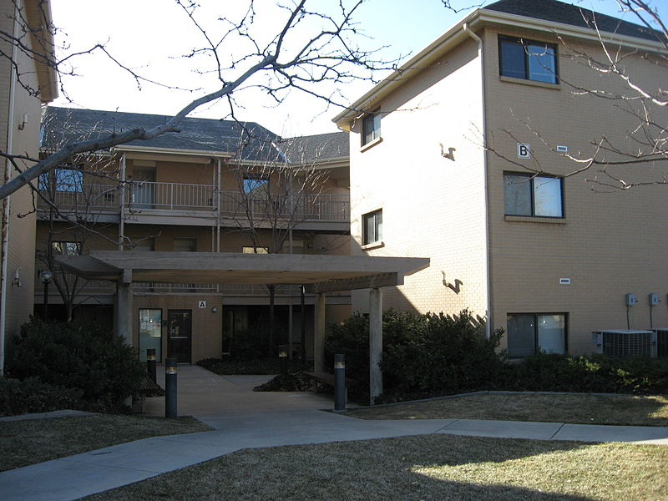
FOUNDATION OF COOPERATION?
Both are worldwide famous universities
For the BYU:
Strong engineering background in SCUT
A longer exchanging program in China
For the SCUT:
A multi-language environment
China needs more specialists
International Students Dormitory

Slide 6
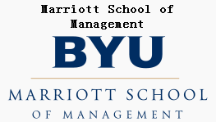


WHAT DO WE EXPECT FROM BYU
School & majors that we are interested in
Business (Marriott School of Management)
School of Accountancy
1st, clubs, Outstanding Educator
School of Finance
21st, clubs
Notes:
We are interested in the Marriott School of Management which has nationally recognized programs in accounting, business management, public management, information systems, and entrepreneurship.
And we want to exchange of students to School of Accountancy an School of Finance.
As we all know, SOA which is school of accountancy ranks 1st and SOF ranks 21st according to Wall Street Journal 2010. There are 2 excellent clubs in SOA—BAP and WSOA.
1.Alpha Psi (BAP)
Is a fraternity offers an opportunity for accounting students to attend weekly lectures by outstanding speakers on subjects which are relevant to today’s accountant and business leader.
2.Women in the SOA (WSOA)
Provides women in the SOA with career options tailored to their individual needs.
Besides, there is a well known professor, Robert Gardner who was recently honored with the prestigious 2013 Outstanding Educator award from the Utah Association of Certified Public Accountants.
“Bob has an incredible knowledge of the tax code and a penchant for teaching students how to research and think critically,” says Jeff Wilks, School of Accountancy director. He received the Marriott School’s Outstanding Faculty award in 2001 and served as the director of the School of Accountancy from 1996–2002. Outside of academia, Gardner received the 2006 Outstanding Service award from the American Taxation Association and served as a member of the American Accounting Association Council and the National Tax Academic Advisory Boards for Ernst & Young and Deloitte & Touche.

Slide 7
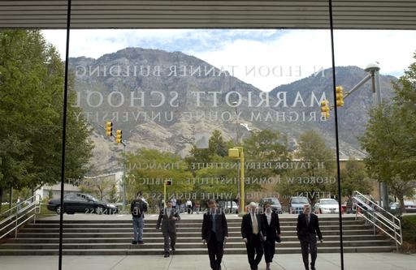

WHAT DO WE EXPECT FROM BYU
Classes that we are interested in
Financial management
Strategic management
Money , banking, and business
Analyses for investment bankers
Economics of strategy
Notes:
Next let’s talk about the courses that we are interested in.
FINANCIAL MANAGEMENT is a classic and fundamental course in every accounting department. As it provides the core methodologies in accounting field, whether a student fully masters this course determine his or her competency in this field. So we SCUT SOA would like to suggest us students to select your Financial Management and benefit from your way of teaching.
Analyses for investment bankers is also an appealing course. Needless to say, US financial market is the most
mature one around the globe…

Slide 8
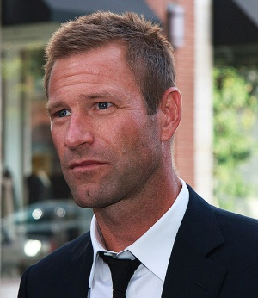
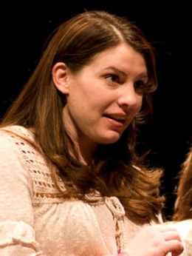


WHAT DO WE EXPECT FROM BYU
Famous alumni
Stephanie Meyer - author of Twilight Saga
Aaron Echkhark - US Actor
Campus life
Food
Rules
Sports(cross country)
Museum
Notes:
Food:Chef de Cuisine:Adam Jones
Rules:
BYU students are required to follow an honor code, which mandates behavior in line with LDS teachings (e.g., academic honesty, adherence to dress and grooming standards, and abstinence from extramarital sex and from the consumption of drugs and alcohol).^{[12]} Many students (78% of men, 10% of women) take a two-year hiatus from their studies at some point to serve as Mormon missionaries.^{[13][}
Sports:
Baseball, Boys Basketball, Cheer and Dance, Cubs Camps, Diving, Fathers and Sons, Football, Girls Basketball, Golf, Gymnastics, Lacrosse, Rugby, Soccer, Softball, Speed and Power, Swimming, Tennis, Track and Field, Volleyball
Say something about Cross Country
MUSEUM:
One of the largest and best-attended art museums in the Mountain West.
The Museum of Art was designed by Los Angeles architect James Langenheim. Former directors of lighting and design at the Metropolitan Museum of Art, LeMar Terry and Stuart Silver, assisted in determining the sophisticated lighting requirements and the best functional use of space.

Slide 9
WHAT DO WE EXPECT FROM BYU

Slide 10
THANK YOU!

